Slide 1
Deep Learning
Week

Slide 2
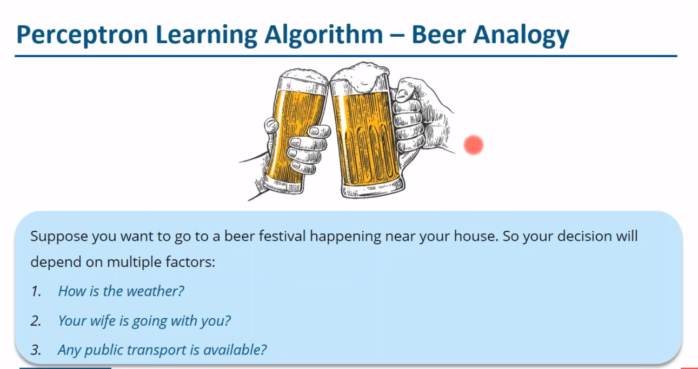

Slide 3
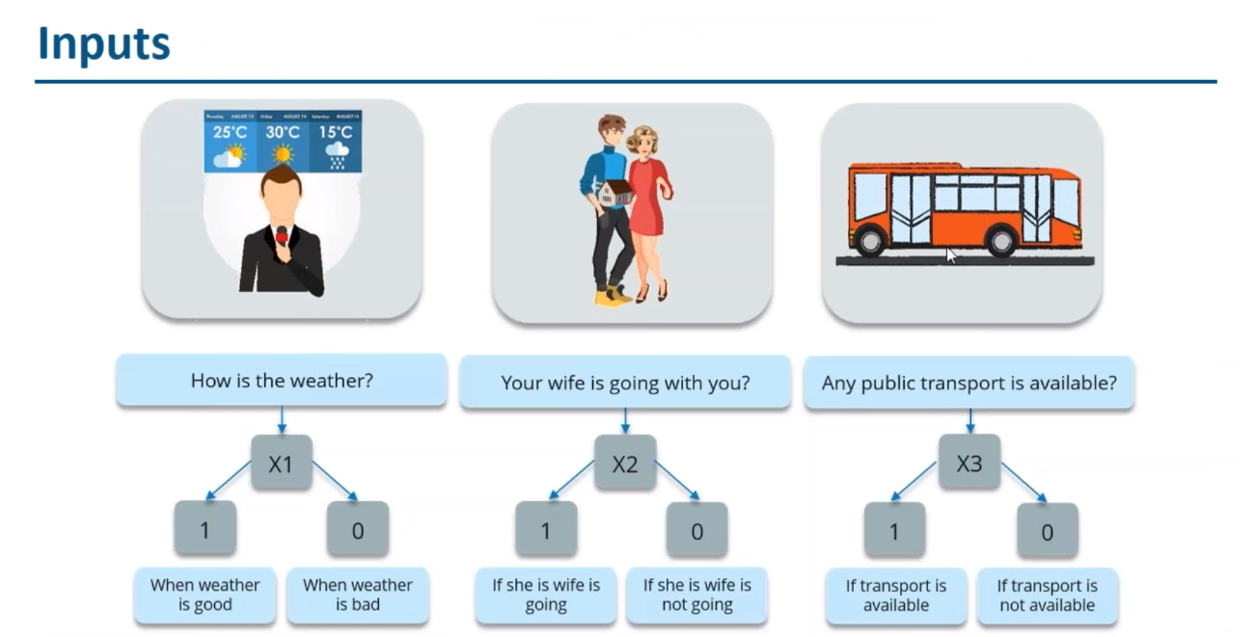

Slide 4
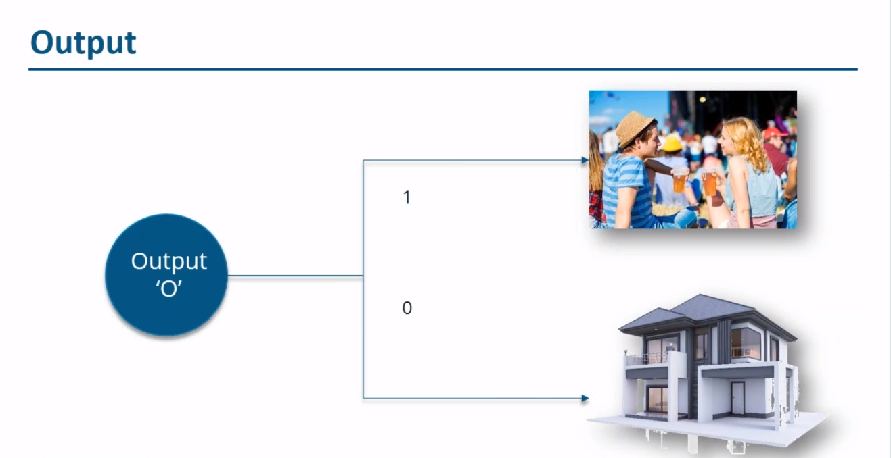

Slide 5
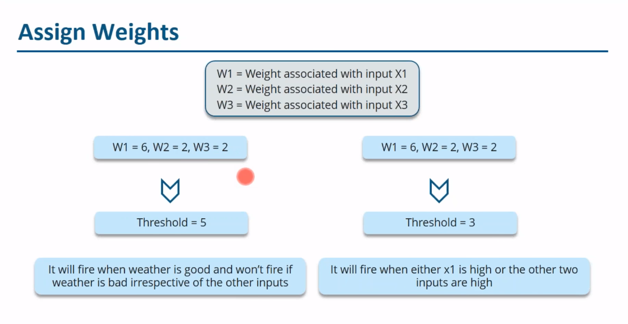

Slide 6
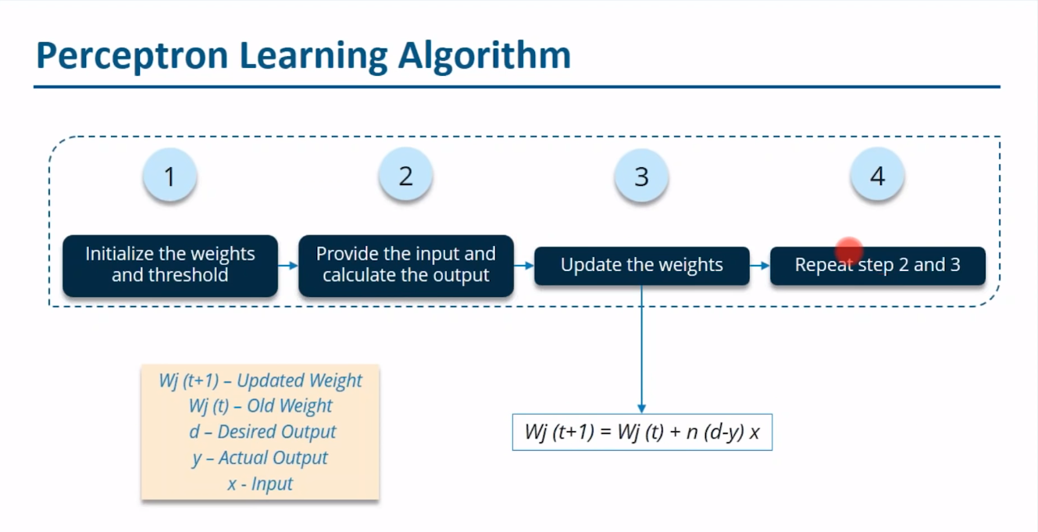

Slide 7
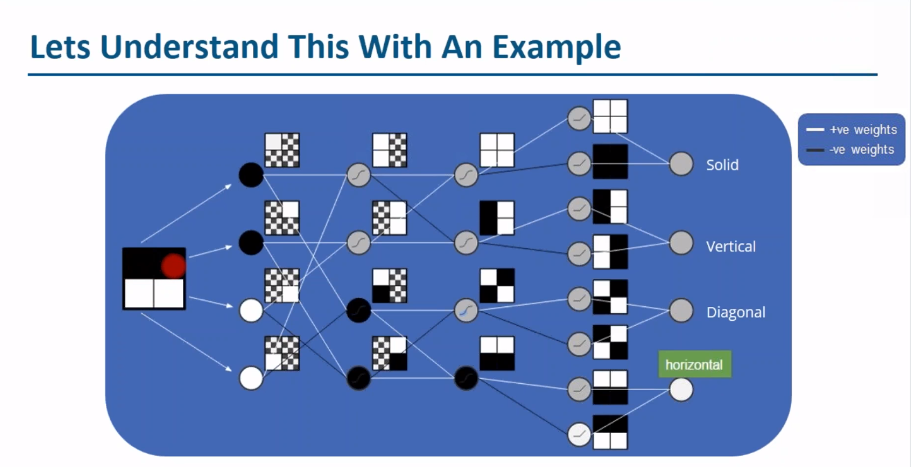
Multi layer Perceptron Algortithm

Slide 8
Backward Propagation
input | Desired Output
0 | 0
1 | 2
2 | 4

Slide 9
input | Desired Output | Model Output(W=3)
0 | 0 | 0
1 | 2 | 3
2 | 4 | 6

Slide 10
input | Desired Output | Model Output(W=3) | Absolute error | Square Error
0 | 0 | 0
1 | 2 | 3
2 | 4 | 6

